Slide 1
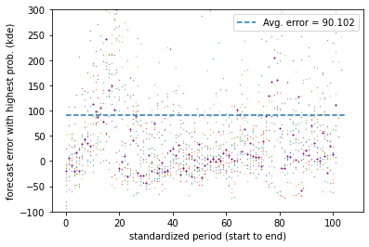
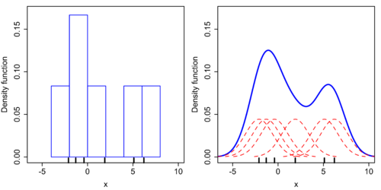


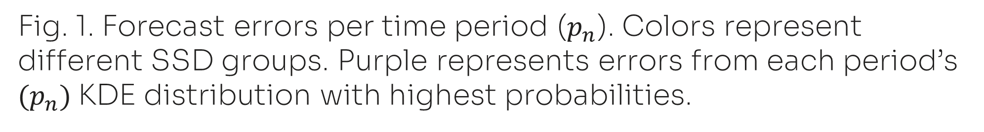
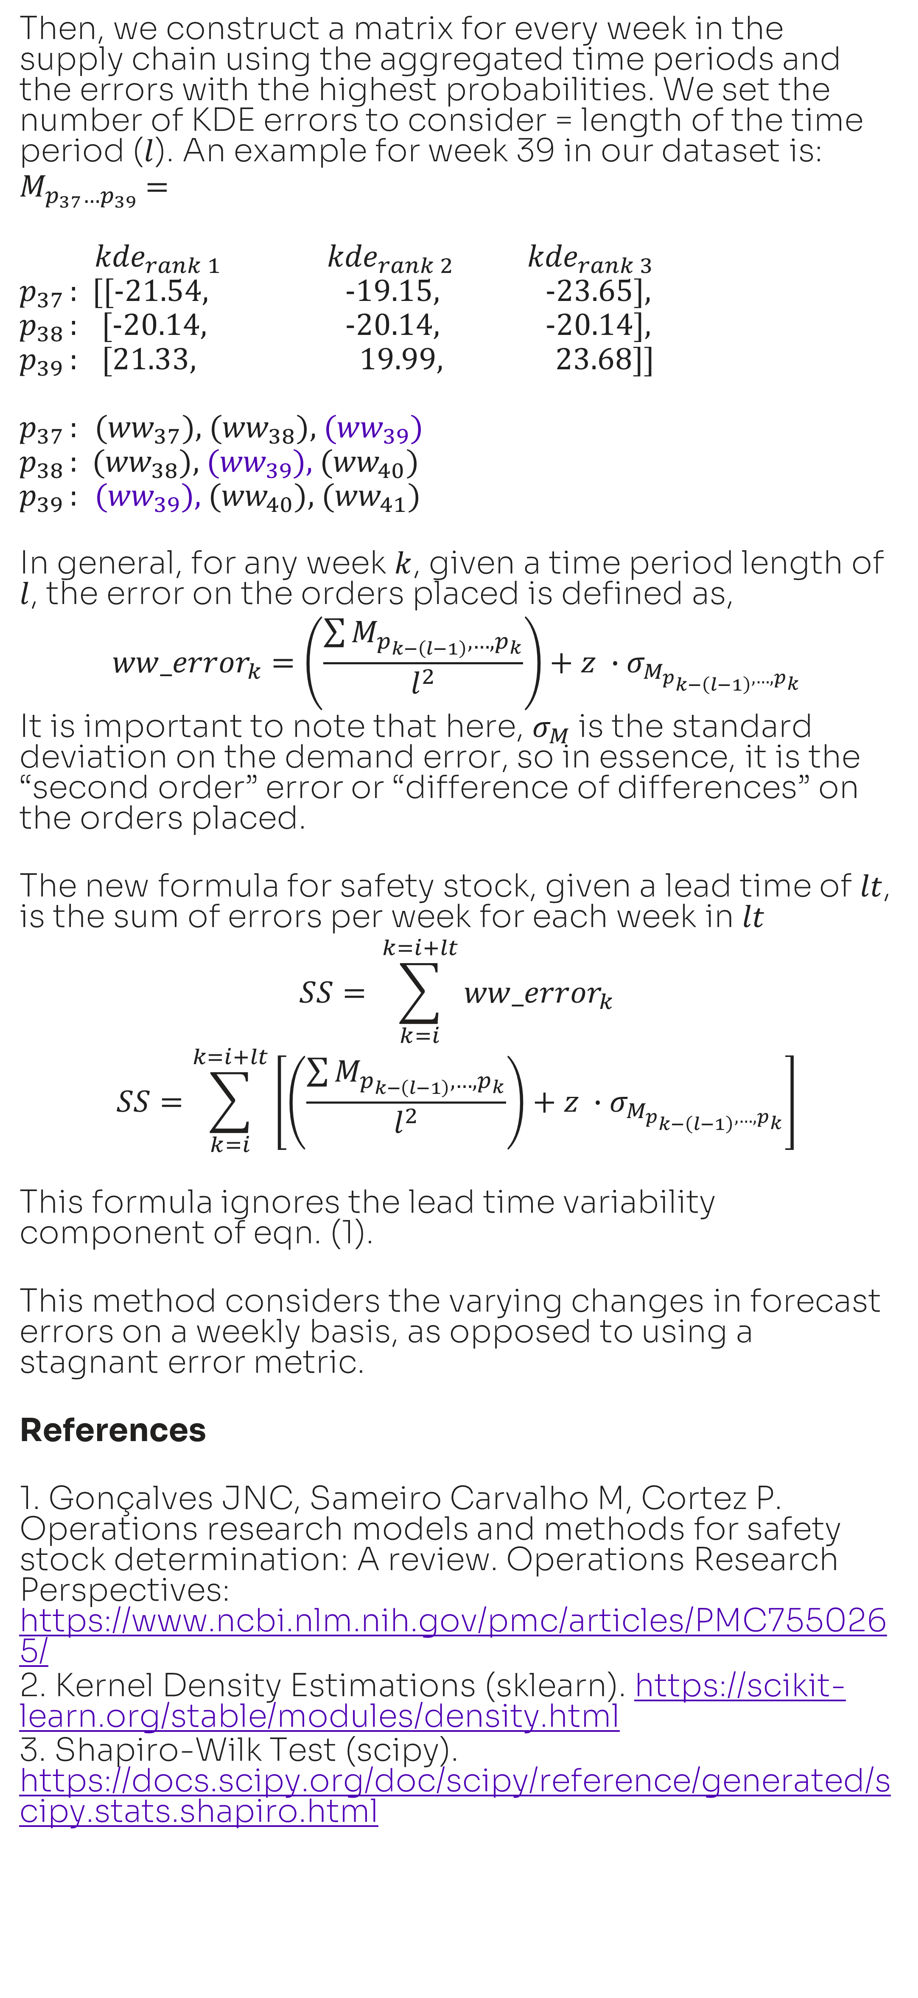
Improving demand forecasts and safety stock calculations in the semiconductor supply chain
Aparna Komarla, Data Scientist, Global Operations & Supply Chain Group - Solidigm
Abstract
Historically, safety stock in SSD supply chains have been calculated by assuming that demand is normally distributed. However, if this is not true, as is frequently the case in Solidigm’s supply chain, the current framework may yield poor results. Further, since the traditional model only considers the previous demand and forecast errors within a given SSD program and does not include ongoing or completed program cycles, the calculation may be ignoring valuable lessons that can be learned from previous forecasting attempts. This work proposes a new model for safety stock calculations that does away with the normal distribution assumption, and instead leverages the frequency-based non-parametric kernel density estimation function. It also draws upon learnings from previous SSD programs.
Data
The dataset consists of 14 selected SSD programs with at least 100 weeks worth of data on actual orders and forecasts. If more than one forecast was made for a given week, they are condensed into a single value using an exponentially weighted mean (forecasts made closer to the date of actual orders are given more weight).
Background
Traditionally, safety stock calculations account for demand variability and lead time (duration between order placement and fulfillment) variability. It assumes that demand and lead time are distributed normally, giving the following equation, $SS=z ∙\sqrt{{L∙σ}_{D}^{2} +{{ (D}_{mean}{∙σ}_{L})}^{2} }$ eqn. (1) Where $σ_{D}$ is the std. deviation of demand ($D$), $σ_{L}$ is the std. deviation of lead-time ($L$), and $z$ is the z-score or “service level”. In this work, we propose an alternative to the demand variability component, $z ∙\sqrt{{L∙σ}_{D}^{2} }$
Across all SSD programs, the mean p-value of orders placed, obtained from the Shapiro-Wilk test for normality, is 0.001. Any p-value of <0.5 implies that the data is non-normal. This is enough reason to explore safety stock calculations that do not rely on normality of demand.
Method
Our goal is to establish a general error vector for demand that can be used to calculate safety stock at any given week in the supply chain for a new SSD program. Traditionally, the demand error across the entire supply chain is set as the std. deviation of orders placed, which is 90 units in our dataset. Clearly, by setting error as a static value, we are overstocking and understocking in several weeks resulting in excess cost for the company.
In the first step, instead of looking at forecast errors per week, we calculate errors across time periods defined as: $p_{n}$= ${ww}_{n}$, ${ww}_{n+1}$, …, ${ww}_{n+(l−1)}$where $l$is the length of the period. The error is therefore,
$${p_error}_{n}=\frac{\sum_{k=n}^{k=n+(l−1)}{{forecast}_{k}} −\sum_{k=n}^{k=n+(l−1)}{{orders}_{k}}}{\sum_{k=n}^{k=n+(l−1)}{{orders}_{k}}}∙100$$
Next, for each time period, $p_{n}$, we use a kernel density estimation to find the forecast error that has the first, second and third highest likelihood of occurrence.
Then, we construct a matrix for every week in the supply chain using the aggregated time periods and the errors with the highest probabilities. We set the number of KDE errors to consider = length of the time period ($l$). An example for week 39 in our dataset is:
$M_{p_{37}…p_{39}}$ =
${kde}_{rank 1}$ ${kde}_{rank 2}$ ${kde}_{rank 3}$
$p_{37}$ : [[-21.54, -19.15, -23.65],
$p_{38}$ : [-20.14, -20.14, -20.14],
$p_{39}$ : [21.33, 19.99, 23.68]]
$p_{37}$ : ${(ww}_{37})$, ${(ww}_{38})$, ${(ww}_{39})$
$p_{38}$ : ${(ww}_{38})$,${ (ww}_{39}),$ ${(ww}_{40})$
$p_{39}$ : ${(ww}_{39})$,${(ww}_{40})$, ${(ww}_{41})$
In general, for any week $k$, given a time period length of $l$, the error on the orders placed is defined as,
$${ww_error}_{k}=\left(\frac{\sum{M_{p_{k−\left(l−1\right)},…, p_{k}}}}{l^{2}}\right)+{z ∙σ}_{M_{p_{k−\left(l−1\right)},…, p_{k}}}$$
It is important to note that here, $σ_{M}$is the standard deviation on the demand error, so in essence, it is the “second order” error or “difference of differences” on the orders placed.
The new formula for safety stock, given a lead time of $lt$, is the sum of errors per week for each week in $lt$
$$SS= \sum_{k=i}^{k=i+lt}{{ww_error}_{k}}$$
$$SS=\sum_{k=i}^{k=i+lt}{\left[\left(\frac{\sum{M_{p_{k−\left(l−1\right)},…, p_{k}}}}{l^{2}}\right)+{z ∙σ}_{M_{p_{k−\left(l−1\right)},…, p_{k}}}\right]}$$
This formula ignores the lead time variability component of eqn. (1).
This method considers the varying changes in forecast errors on a weekly basis, as opposed to using a stagnant error metric.
References
1. Gonçalves JNC, Sameiro Carvalho M, Cortez P. Operations research models and methods for safety stock determination: A review. Operations Research Perspectives: https://www.ncbi.nlm.nih.gov/pmc/articles/PMC7550265/
2. Kernel Density Estimations (sklearn). https://scikit-learn.org/stable/modules/density.html
3. Shapiro-Wilk Test (scipy). https://docs.scipy.org/doc/scipy/reference/generated/scipy.stats.shapiro.html
Fig. 1. Forecast errors per time period ($p_{n}$). Colors represent different SSD groups. Purple represents errors from each period’s ${(p}_{n})$KDE distribution with highest probabilities.
Fig. 2. Graphical explanation of KDE distribution for a given time period. The histogram represents the frequency of each forecast error in the time period.
Thanks to Naveen Divakaran (former Sr. Operations Research Engineer @ Solidigm) for his guidance with establishing the datasets and problem statement.

